Slide 2
Listening To The Teachings About The Creator From The Creation

Slide 3
Clearly Seeing The Attributes Of God
Romans 1:20
For since the creation of the world His invisible attributes are clearly seen, being understood by the things that are made, even His eternal power and Godhead, so that they are without excuse,

Slide 4
Clearly Hearing The Creation
Psalms 19:1-4
The heavens declare the glory of God; And the firmament shows His handiwork. 2 Day unto day utters speech, And night unto night reveals knowledge.

Slide 5
Clearly Hearing The Creation
Psalms 19:1-4
3 There is no speech nor language Where their voice is not heard. 4 Their line has gone out through all the earth, And their words to the end of the world.

Slide 6
The Power Of The Creator Seen In The Creation
Isaiah 40:25-26
25 "To whom then will you liken Me, Or to whom shall I be equal?" says the Holy One. 26 Lift up your eyes on high, And see who has created these things, Who brings out their host by number; He calls them all by name, By the greatness of His might And the strength of His power; Not one is missing.

Slide 7
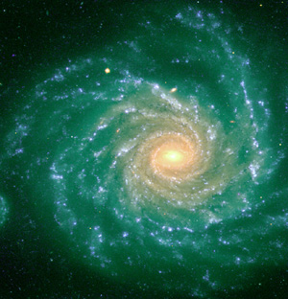
He calls them all by name.

Slide 8
The Power Of The Creator Seen In The Creation
Our Universe has over 25 sextillion stars in it (that’s the number 25 followed by 21 zeros!) They say it contains over one billion galaxies, each of which has an estimated 100 billion individual stars.
(Truth Be Told, p. 5, Kyle Butt and Eric Lyons)

Slide 9
The Power Of The Creator Seen In The Creation
Jeremiah 32:17
'Ah, Lord GOD! Behold, You have made the heavens and the earth by Your great power and outstretched arm. There is nothing too hard for You.

Slide 10
The Wisdom Of God Seen In The Heavens And The Earth
Psalm 147:4-5
4 He counts the number of the stars; He calls them all by name. 5 Great is our Lord, and mighty in power; His understanding is infinite.

Slide 11
The Understanding Of God Seen In The Creation
Psalm 104:24
O LORD, how manifold are Your works! In wisdom You have made them all. The earth is full of Your possessions —

Slide 12
The Understanding Of God Seen In The Heavens And The Earth
Proverbs 3:19
The LORD by wisdom founded the earth; By understanding He established the heavens;

Slide 13
The Understanding Of God Seen In The Design Of The Earth
Isaiah 40:28
Have you not known? Have you not heard? The everlasting God, the LORD, The Creator of the ends of the earth, Neither faints nor is weary. His understanding is unsearchable.

Slide 14
The Understanding Of God Seen In The Heavens And The Earth
Isaiah 45:18
For thus says the LORD, Who created the heavens, Who is God, Who formed the earth and made it, Who has established it, Who did not create it in vain, Who formed it to be inhabited: "I am the LORD, and there is no other.

Slide 15
The Understanding Of God Seen In The Heavens And The Earth
Job 38:4-12
4 "Where were you when I laid the foundations of the earth? Tell Me, if you have understanding. 5 Who determined its measurements? Surely you know! Or who stretched the line upon it? 6 To what were its foundations fastened? Or who laid its cornerstone, 7 When the morning stars sang together, And all the sons of God shouted for joy?

Slide 16
The Understanding Of God Seen In The Heavens And The Earth
Job 38:4-12
8 "Or who shut in the sea with doors, When it burst forth and issued from the womb; 9 When I made the clouds its garment, And thick darkness its swaddling band; 10 When I fixed My limit for it, And set bars and doors; 11 When I said, 'This far you may come, but no farther, And here your proud waves must stop!'

Slide 17
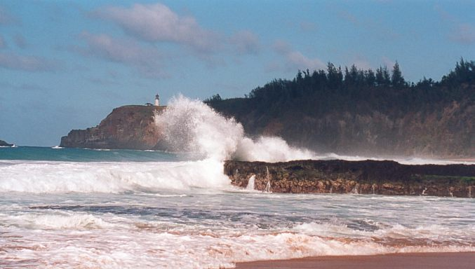
Here your proud waves must stop.

Slide 18
The Understanding Of God Seen In The Heavens And The Earth
Job 38:4-12
12 "Have you commanded the morning since your days began, And caused the dawn to know its place,

Slide 19
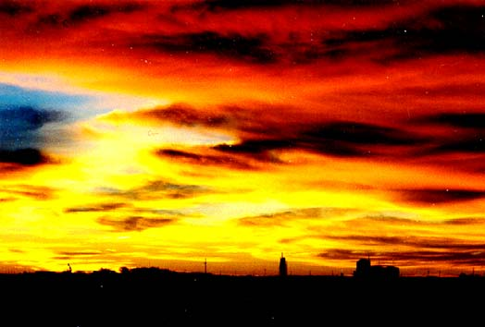
Have you commanded the morning?

Slide 20
The Understanding Of God Seen In The Heavens And The Earth
Job 38:32-33
"Can you lead forth a constellation in its season, And guide the Bear with her satellites? "Do you know the ordinances of the heavens, Or fix their rule over the earth?

Slide 21
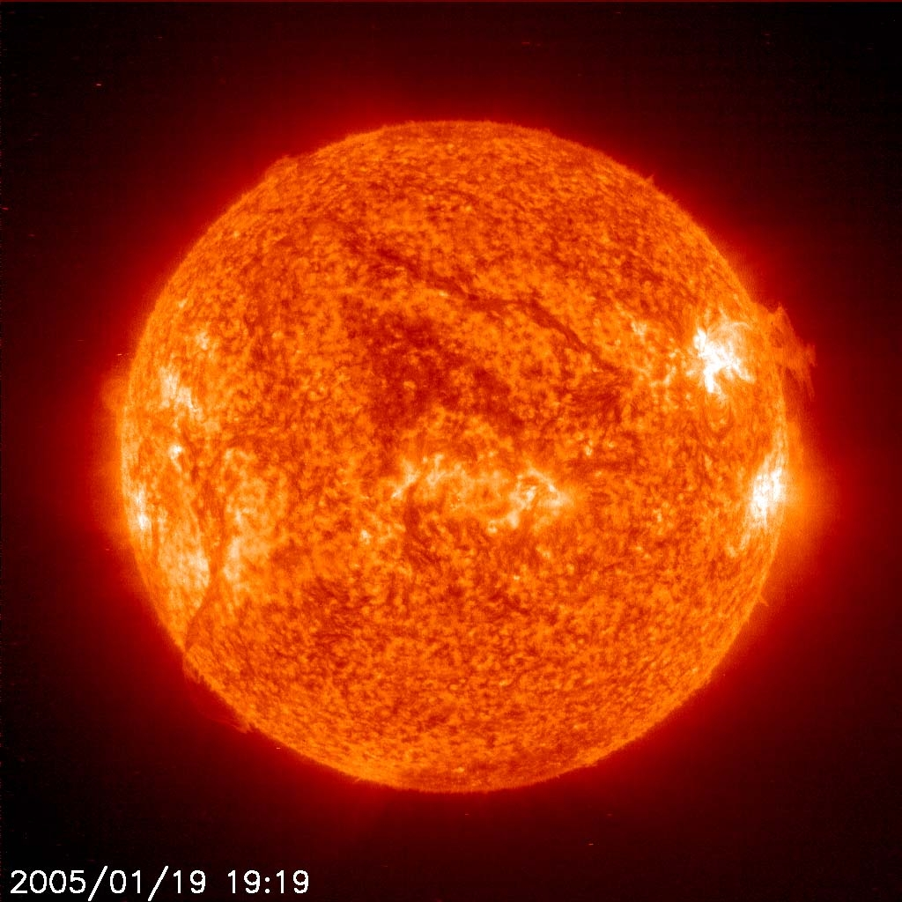
Do you know the ordinances of the heavens?

Slide 22
The Understanding Of God Seen In The Heavens And The Earth
The sun converts 8 million tons of matter into energy every single second, and has an interior temperature of more than 20 million degrees Celsius.
(Truth Be Told, p.15, Kyle Butt and Eric Lyons)

Slide 23
The Understanding Of God Seen In The Heavens And The Earth
As the earth travels in its orbit around the Sun (a distance of 600 million Miles!), it moves at a speed of approximately 70,000 miles per hour, or 19 miles per second. But as it moves, it veers from a straight line only one-ninth of an inch every eighteen miles.

Slide 24
The Understanding Of God Seen In The Heavens And The Earth
If it veered by one-tenth of an inch, the orbit would become so large that life on the Earth would be impossible due to drastically reduced temperatures; if it veered by one-eighth of an inch, life on the Earth would be impossible due to drastically increased temperatures. Yet the Earth veers from a straight line only one-ninth of an inch, which is just right.
(Kyle Butt and Eric Lyons, Truth Be Told, p. 18)

Slide 25
The Understanding Of God Seen In The Design Of Nature
Job 39:26-29
26 "Does the hawk fly by your wisdom, And spread its wings toward the south?

Slide 26
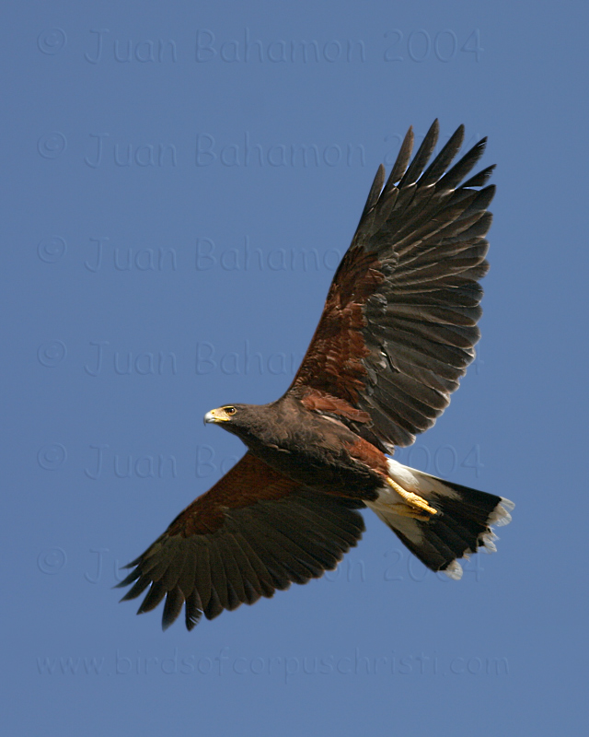
Does the hawk fly by your wisdom?

Slide 27
The Understanding Of God Seen In The Design Of Nature
Job 39:26-29
27 Does the eagle mount up at your command, And make its nest on high? 28 On the rock it dwells and resides, On the crag of the rock and the stronghold. 29 From there it spies out the prey; Its eyes observe from afar.

Slide 28
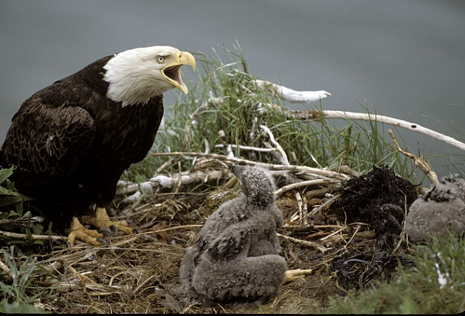
Does the eagle make it’s nest on high at your command?

Slide 29
The Understanding Of God Seen In The Design Of Man
Psalm 139:14
I will praise You, for I am fearfully and wonderfully made; Marvelous are Your works, And that my soul knows very well.

Slide 30
The Understanding Of God Seen In The Design Of Man
Acts 17:28
for in Him we live and move and have our being, as also some of your own poets have said, 'For we are also His offspring.'

Slide 31
The Understanding Of God Seen In The Design Of Man
Ecclesiastes 11:5
As you do not know what is the way of the wind, Or how the bones grow in the womb of her who is with child, So you do not know the works of God who makes everything.

Slide 32
The Understanding Of God Seen In The Design Of Man
Proverbs 20:12
The hearing ear and the seeing eye, The LORD has made them both.

Slide 33
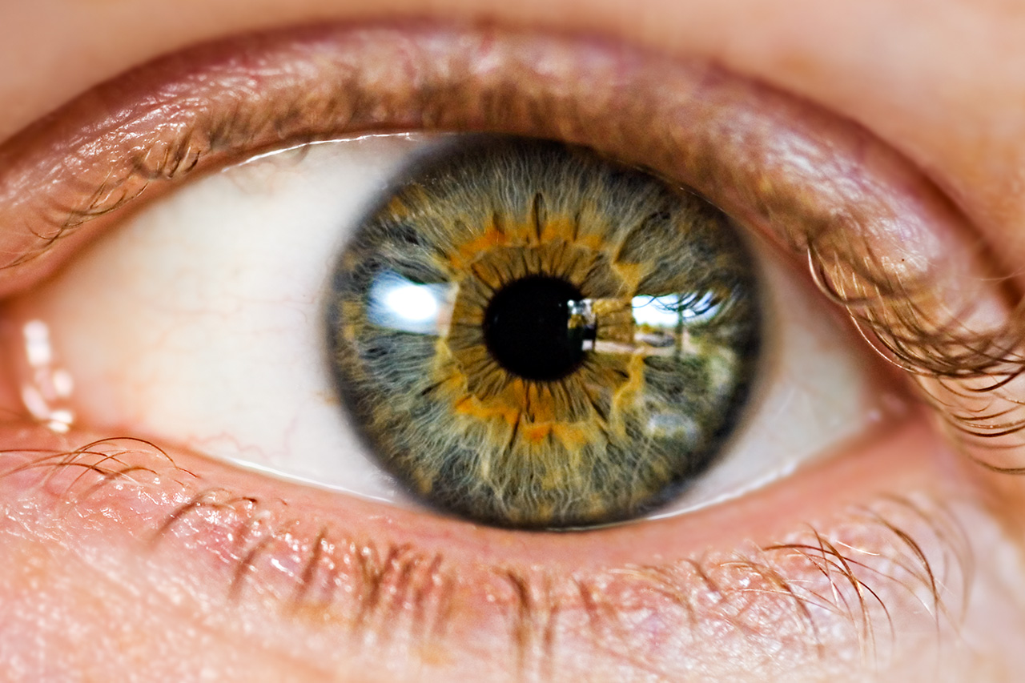
The Lord has made the seeing eye.

Slide 34
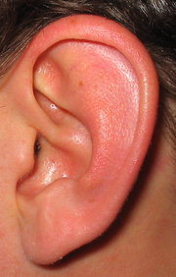
The Lord has made the hearing ear.

Slide 35
The Understanding Of God Seen In The Design Of Man
Job 38:36
Who has put wisdom in the mind? Or who has given understanding to the heart?

Slide 36
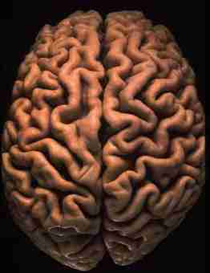
Who has put wisdom in the mind?

Slide 37
The Glory Of God Seen In The Creation
Psalm 19:1
The heavens declare the glory of God; And the firmament shows His handiwork.

Slide 38
The Glory Of God Seen In The Creation
Genesis 1:31
Then God saw everything that He had made, and indeed it was very good. So the evening and the morning were the sixth day.

Slide 39
The Glory Of God Seen In The Creation
Ecclesiastes 3:11
He has made everything beautiful in its time. Also He has put eternity in their hearts, except that no one can find out the work that God does from beginning to end.

Slide 40
The Glory Of God Seen In The Creation
Revelation 4:11
"You are worthy, O Lord, To receive glory and honor and power; For You created all things, And by Your will they exist and were created."

Slide 41
The Glory Of God Seen In The Creation
Psalm 148:1-13
Praise the LORD! Praise the LORD from the heavens; Praise Him in the heights!
2 Praise Him, all His angels; Praise Him, all His hosts!
3 Praise Him, sun and moon; Praise Him, all you stars of light!

Slide 42
The Glory Of God Seen In The Creation
Psalm 148:1-13
4 Praise Him, you heavens of heavens, And you waters above the heavens!
5 Let them praise the name of the LORD, For He commanded and they were created.
6 He also established them forever and ever; He made a decree which shall not pass away.

Slide 43
The Glory Of God Seen In The Creation
Psalm 148:1-13!
7 Praise the LORD from the earth, You great sea creatures and all the depths;
8 Fire and hail, snow and clouds; Stormy wind, fulfilling His word;
9 Mountains and all hills; Fruitful trees and all cedars;

Slide 44
The Glory Of God Seen In The Creation
Psalm 148:1-13
10 Beasts and all cattle; Creeping things and flying fowl;
11 Kings of the earth and all peoples; Princes and all judges of the earth;
12 Both young men and maidens; Old men and children.

Slide 45
The Glory Of God Seen In The Creation
Psalm 148:13-14
13 Let them praise the name of the LORD, For His name alone is exalted; His glory is above the earth and heaven.

